Slide 1
SQL Index
All about Index

Slide 2
Why Indexes?
Indexes are used by queries to find data from tables quickly. Indexes are created on tables and views. Index on a table or a view, is very similar to an index that we find in a book.
If you don't have an index in a book, and I ask you to locate a specific chapter in that book, you will have to look at every page starting from the first page of the book. On, the other hand, if you have the index, you lookup the page number of the chapter in the index, and then directly go to that page number to locate the chapter. Obviously, the book index is helping to drastically reduce the time it takes to find the chapter. In a similar way, Table and View indexes, can help the query to find data quickly. In fact, the existence of the right indexes, can drastically improve the performance of the query. If there is no index to help the query, then the query engine, checks every row in the table from the beginning to the end. This is called as Table Scan. Table scan is bad for performance.
Sql Server Index will store data in ascending order by default.

Slide 3
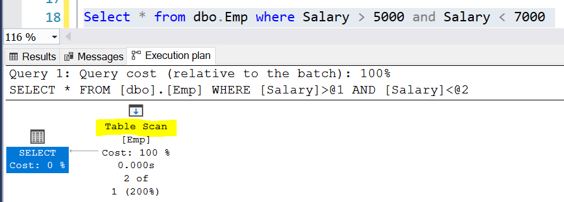
Table Scan and Index Seek
Consider, the following query Select * from dbo.Emp where Salary > 5000 and Salary < 7000
To find all the employees, who has salary greater than 5000 and less than 7000, the query engine has to check each and every row in the table, resulting in a table scan, which can adversely affect the performance, especially if the table is large. Since there is no index, to help the query, the query engine performs an entire table scan.

Slide 4
Now Let's Create the Index to help the query:
General Syntax – CREATE Index IndexName ON TableName (Col1, COL2.. ASC/DESC)
Here, we are creating an index on Salary column in the employee table CREATE Index IX_tblEmployee_Salary ON tblEmployee (SALARY ASC) The index stores salary of each employee, in the ascending order.
Now, when the SQL server has to execute the same query, it has an index on the salary column to help this query.
SQL server picks up the row addresses from the index and directly fetch the records from the table, rather than scanning each row in the table. This is called as Index Seek.
To delete or drop the index: When dropping an index, specify the table name as well
General Syntax – DROP INDEX SchemaName.TableName.IndexName
-- Drop Index tblEmployee.IX_tblEmployee_Salary

Slide 5
Types Of Index
The following are the different types of indexes in SQL Server 1. Clustered 2. Nonclustered 3. Unique 4. Filtered 5. XML 6. Full Text 7. Spatial 8. Columnstore 9. Index with included columns 10. Index on computed columns
From the list above we are going to learn Clustered and NON-Clustered Index

Slide 6
Clustered Index:
A clustered index determines the physical order of data in a table. Primary key by default creates clustered index on a table. For this reason, a table can have only one clustered index.
Create tblEmployees table using the script below. CREATE TABLE [tblEmployee] ( [Id] int Primary Key, [Name] nvarchar(50), [Salary] int, [Gender] nvarchar(10), [City] nvarchar(50) ) Note that Id column is marked as primary key. Primary key, constraint create clustered indexes automatically if no clustered index already exists on the table.

Slide 7
Now execute the following insert queries. Note that, the values for Id column are not in a sequential order. Insert into tblEmployee Values(3,'John',4500,'Male','New York') Insert into tblEmployee Values(1,'Sam',2500,'Male','London') Insert into tblEmployee Values(4,'Sara',5500,'Female','Tokyo') Insert into tblEmployee Values(5,'Todd',3100,'Male','Toronto') Insert into tblEmployee Values(2,'Pam',6500,'Female','Sydney') Execute the following SELECT query Select * from tblEmployee
Inspite, of inserting the rows in a random order, when we execute the select query we can see that all the rows in the table are arranged in an ascending order based on the Id column. This is because a clustered index determines the physical order of data in a table, and we have got a clustered index on the Id column.
Because of the fact that, a clustered index dictates the physical storage order of the data in a table, a table can contain only one clustered index. If you take the example of tblEmployee table, the data is already arranged by the Id column, and if we try to create another clustered index on the Name column, the data needs to be rearranged based on the NAME column, which will affect the ordering of rows that's already done based on the ID column.
For this reason, SQL server doesn't allow us to create more than one clustered index per table.

Slide 8
Clustered Index..cont
We just learnt that, a table can have only one clustered index. However, the index can contain multiple columns (a composite index), like the way a telephone directory is organized by last name and first name.
Let's now create a clustered index on 2 columns.
To create a composite clustered Index on the Gender and Salary columns. Create Clustered Index IX_tblEmployee_Gender_Salary ON tblEmployee(Gender DESC, Salary ASC)
Now, if you issue a select query against this table you should see the data physically arranged, FIRST by Gender in descending order and then by Salary in ascending order.

Slide 9
Non Clustered Index:
A nonclustered index is analogous to an index in a textbook. The data is stored in one place, the index in another place. The index will have pointers to the storage location of the data. Since, the nonclustered index is stored separately from the actual data, a table can have more than one non clustered index, just like how a book can have an index by Chapters at the beginning and another index by common terms at the end.
The following SQL creates a Nonclustered index on the NAME column on tblEmployee table: Create NonClustered Index IX_tblEmployee_Name ON tblEmployee(Name)
Difference between Clustered and NonClustered Index: 1. Only one clustered index per table, where as you can have more than one non clustered index 2. Clustered index is faster than a non clustered index, because, the non-clustered index has to refer back to the table, if the selected column is not present in the index. 3. Clustered index determines the storage order of rows in the table, and hence doesn't require additional disk space, but where as a Non Clustered index is stored seperately from the table, additional storage space is required.

Slide 10
Advantages
Not only, the SELECT statement, even the following DELETE and UPDATE statements can also benefit from the index. To update or delete a row, SQL server needs to first find that row, and the index can help in searching and finding that specific row quickly.
Indexes can also help queries, that ask for sorted results. Since the Salaries are already sorted, the database engine, simply scans the index from the first entry to the last entry and retrieve the rows in sorted order. This avoids, sorting of rows during query execution, which can significantly imrpove the processing time. Select * from tblEmployee order by Salary asc/desc
GROUP BY queries can also benefit from indexes. To group the Employees with the same salary, the query engine, can use the index on Salary column, to retrieve the already sorted salaries. Since matching salaries are present in consecutive index entries, it is to count the total number of Employees at each Salary quickly. Select Salary, COUNT(Salary) as Total from tblEmployee Group By Salary

Slide 11
Disadvantages
Diadvantages of Indexes: Additional Disk Space: Clustered Index does not, require any additional storage. Every Non-Clustered index requires additional space as it is stored separately from the table.The amount of space required will depend on the size of the table, and the number and types of columns used in the index. Insert Update and Delete statements can become slow: When DML (Data Manipulation Language) statements (INSERT, UPDATE, DELETE) modifies data in a table, the data in all the indexes also needs to be updated. Indexes can help, to search and locate the rows, that we want to delete, but too many indexes to update can actually hurt the performance of data modifications.

Slide 12
Questions??

Slide 13
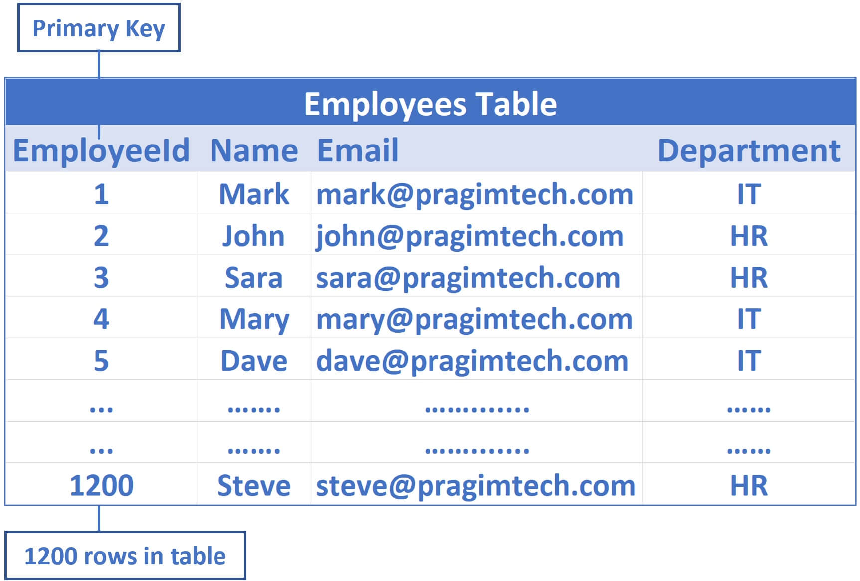
How Indexes work/Store Data
Consider the following table with Clustered index on ID column:

Slide 14
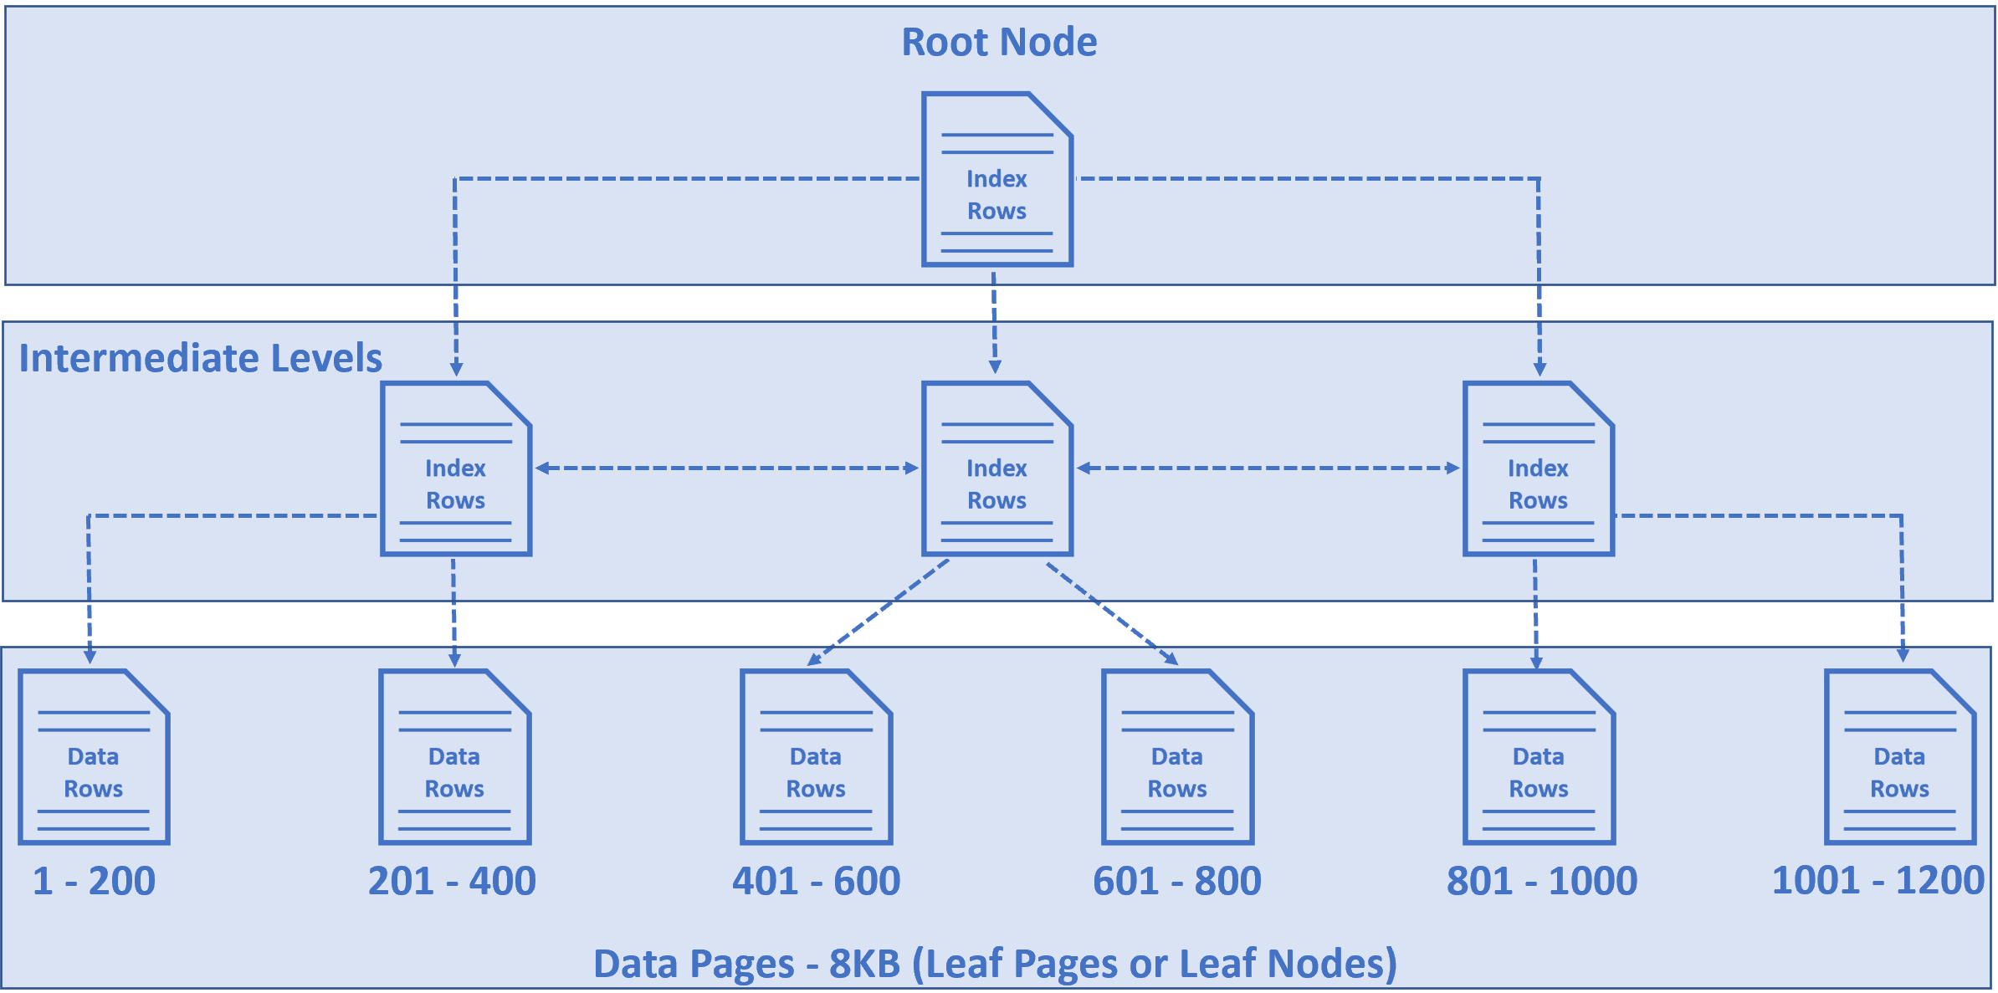
EmployeeId is the primary key, so by default a clusterd index on the EmployeeId column is created.
This means employee data is sorted by EmployeeId column and physically stored in a series of
data pages in a tree like structure that looks like the following.

Slide 15
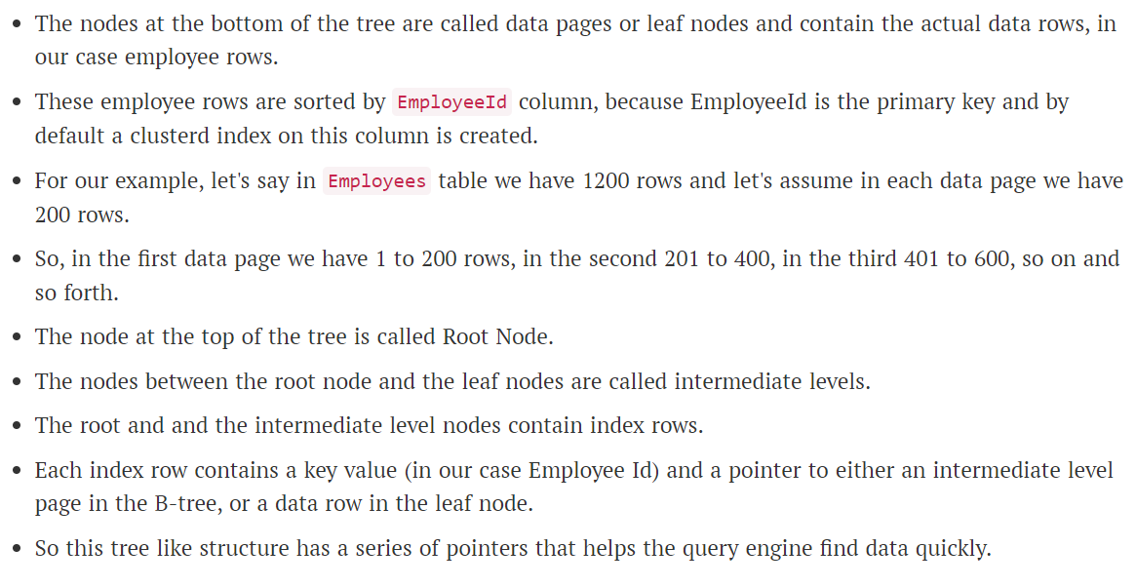

Slide 16
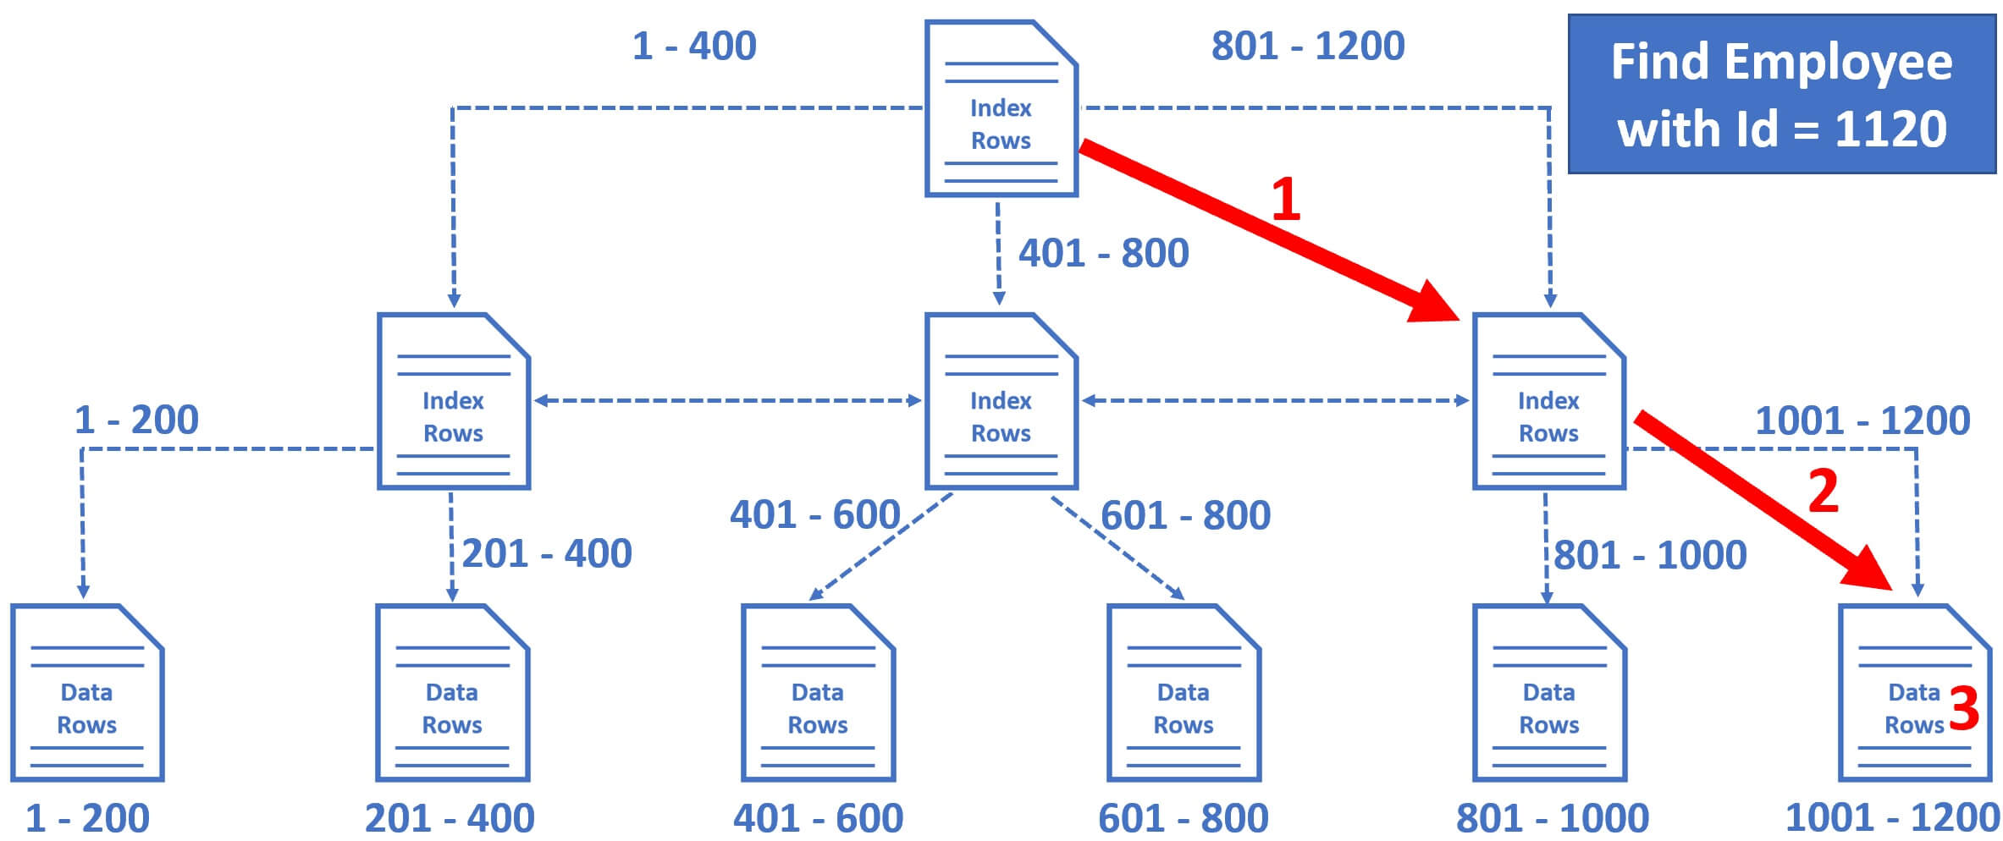
How SQL Server finds a row by ID
So the database engine starts at the root node and it picks the index node on the right, because the database engine knows it is this node that contains employee IDs from 801 to 1200.
From there, it picks the leaf node that is present on the extreme right, because employee data rows from 1001 to 1200 are present in this leaf node.
The data rows in the leaf node are sorted by Employee ID, so it's easy for the database engine to find the employee row with Id = 1120.
Notice in just 3 operations, SQL Server is able to find the data we are looking for. It's making use of the clustered index we have on the table. Let's look at this in action.

Slide 17
Script to create Employees table
Create Table Employees
( Id int primary key identity,
[Name] nvarchar(50),
Email nvarchar(50),
Department nvarchar(50) )
Go
Declare @counter int = 1
While(@counter <= 1000000)
Begin
Declare @Name nvarchar(50) = 'ABC ' + RTRIM(@counter)
Declare @Email nvarchar(50) = 'abc' + RTRIM(@counter) + '@pragimtech.com'
Declare @Dept nvarchar(10) = 'Dept ' + RTRIM(@counter)
Insert into Employees values (@Name, @Email, @Dept)
Set @counter = @counter +1
If(@Counter%100000 = 0) Print RTRIM(@Counter) + ' rows inserted'
End

Slide 18
Clustered Index Seek
The operation is Clustered Index Seek, meaning the database engine is using the clustered index on the employee Id column to find the employee row with Id = 932000.
Number of rows read = 1
Actual number of rows for all executions = 1
Clustered Index Scan
In this example, there is a clustered index on EmployeeId column, so when we search by employee id, SQL Server can easily and quickly find the data we are looking for. What if we serach by Employee name? At the moment, there is no index on the Name column, so there is no easy way for sql server to find the data we are looking for. SQL server has to read every record in the table which is extremely inefficient from performace standpoint.

Slide 19
Execute the query below:
Select * from Employees Where Name = 'ABC 932000‘
Now if you see actual execution plan, The operation is clustered index scan. Since there is no proper index to help this query, the database engine has no other choice than to read every record in the table. This is exactly the reason why Number of rows read is 1 million, i.e every row in the table.
How many rows are we expecting in the result? Well, only one row because there is only one employee whose Name = 'ABC 932000'. So, to produce this 1 row as the result, SQL server has to read all the 1 million rows from the table because there is no index to help this query. This is called Index Scan and in general, Index Scans are bad for performance.

Slide 20
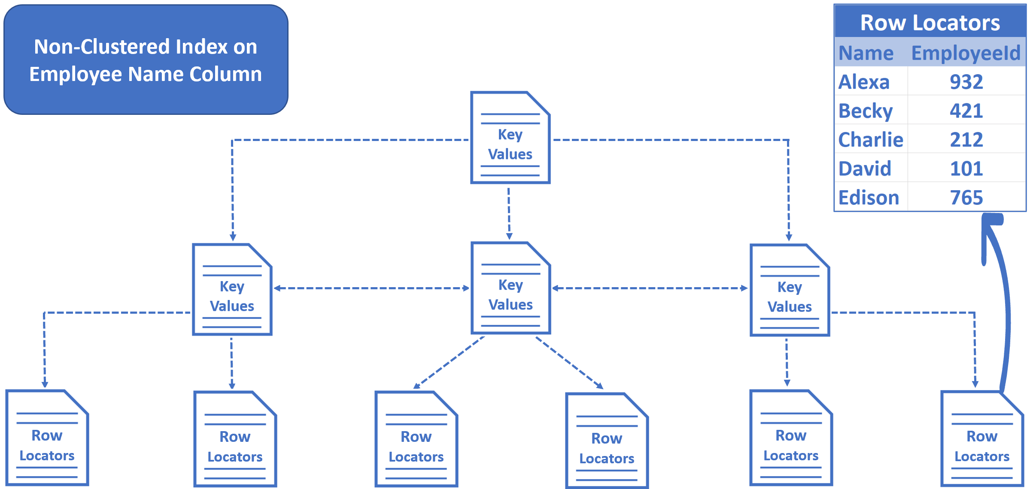
Non-Clustered Index in SQL Server
This is when we create a non-clustered index on the Name column.
CREATE NONCLUSTERED INDEX IX_Employees_Name ON [dbo].[Employees] ([Name])

Slide 21
In an non-clusterd index we do not have table data. We have key values and row locators.
We created a non-clustered index on the Name column, so the key values, in this case Employee names are sorted and stored in alphabetical order.
The row locators at the bottom of the tree contain Employee Names and cluster key of the row. In our example, Employee Id is the cluster key.
Run the query and see execution plan:
Select * from Employees Where Name = 'ABC 932000'

